Slide 1


Hospital Management System: Streamlining Healthcare Operations
This presentation shows a simple Hospital Management System (HMS) that can make hospital operations easier and automated. The paper highlights the features, functionalities, and scopes for improvement related to this system..
BY:-
D.JATHIN [AP23110010726]
SIRI.K [AP23110010777]

Slide 2

Key Functionalities of the HMS
Patient Management
Appointment Scheduling
Billing
This involves adding new patient records with complete information, appending diagnosis details to the existing records, and viewing comprehensive medical histories.
The system allows one to add appointments with patient ID, doctor details, date, and time. It also allows one to look at the existing appointments.
It allows users to prepare patient bills, derived according to the services rendered, medicines prescribed, and room charges, thus streamlining financial procedures.

Slide 3

Technical Implementation: A Deep Dive
File-Based Storage
User Interface
The system maintains patient information and appointments separately in text files, thus easy data management.
The HMS uses a text-based console interface for user interaction, thus providing a simple and direct approach.
Security
The system does offer a simple password-based login mechanism. However, it misses advanced security features, for example, password hashing or encryption.

Slide 4

Objectives: Enhancing Efficiency and Patient Care
1
Streamlined Patient Record Management
2
Efficient Appointment Scheduling
The system will thus simplify the creation, access, and updating of patient records, enhancing data organization and accessibility.
The HMS automates appointment scheduling, reduces scheduling conflicts, and improves appointment management.
3
Improved Billing Management
By automating bill generation, the system simplifies the billing process, ensuring accurate and timely billing.

Slide 5
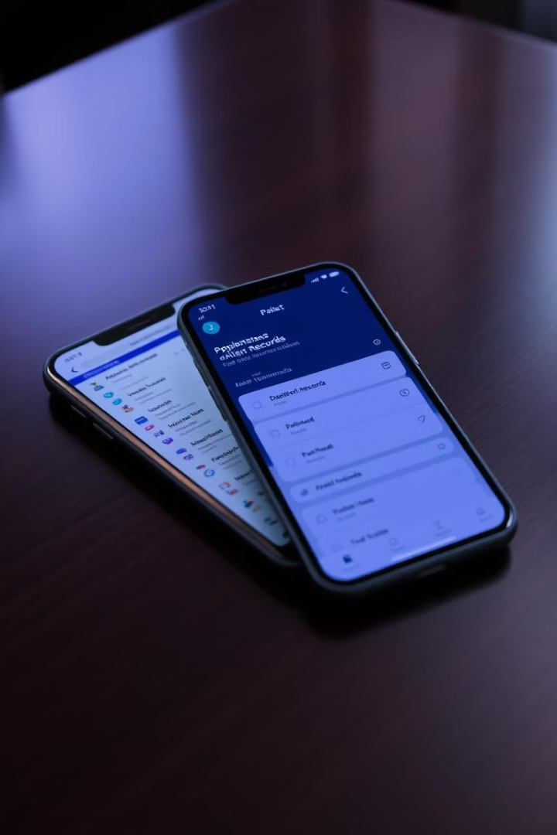



Future Enhancements: Building a More Comprehensive System
Database Integration
Moving from text files to a database will improve data management efficiency, security, and scalability for larger datasets.
User Management and Access Control
Implementing role-based access control will enhance security and restrict access to sensitive information based on user roles.
Mobile Application Development
Developing mobile apps for patients and staff will allow for convenient access to appointments, records, and other essential functions.

Slide 6



System Design: A Well-Structured Approach
Data Structures
1
Classes
2
Separate classes are used to model patients, doctors, and billing details.
Functions
3
Modular functions handle specific operations, ensuring code organization and readability.

Slide 7
User Experience: Improving Interaction and Accessibility
1
Graphical Interface
2
User Authentication
3
Data Validation
4
Error Handling

Slide 8

Conclusion: A Foundation for Efficient Healthcare Operations
1
Modular Design
The HMS employs modular functions, enhancing code organization and readability.
2
Input Validation
User input is validated for correctness and format.
3
User-Friendly Interface
Menus, prompts, and feedback messages guide users effectively through the system.

Slide 9
THANK YOU

